Slide 1
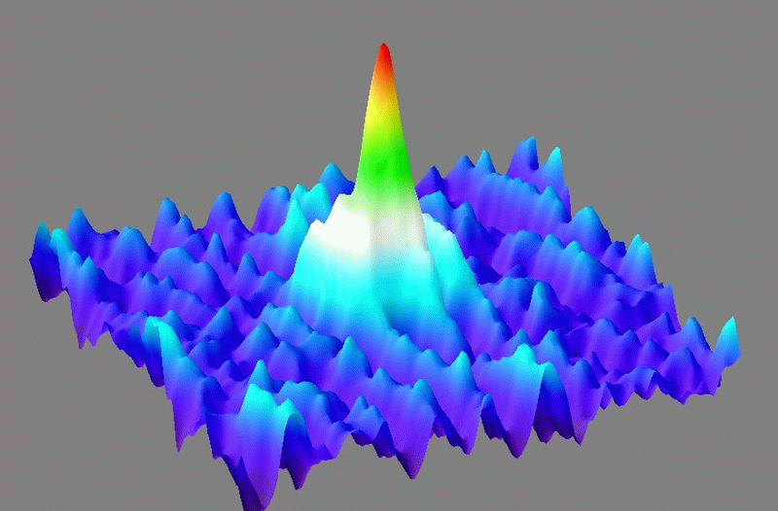

CP301-Development Engineering Project
Supervisor: Dr. Sundeep Gautam
Development of a Python Toolbox to Calculate the Excitation Spectrum of Dipolar Condensates
Khushi Tapariya-2022EPB1235
Priyanshu Kumar-2022EPB1243

Slide 2
MOTIVATION
To understand the concept of Bose-Einstein Condensates
Important for studying quantum many-body systems and exotic phenomena like roton modes and structured phases.
Excitation spectrum reveals:
Collective excitations
Stability and instabilities
Phase transitions
Analytical solutions are limited — numerical tools are essential.
Need for a Python toolbox that:
Computes ground states and excited state energy spectra
Handles dipolar interactions
User friendly and extend for research

Slide 3

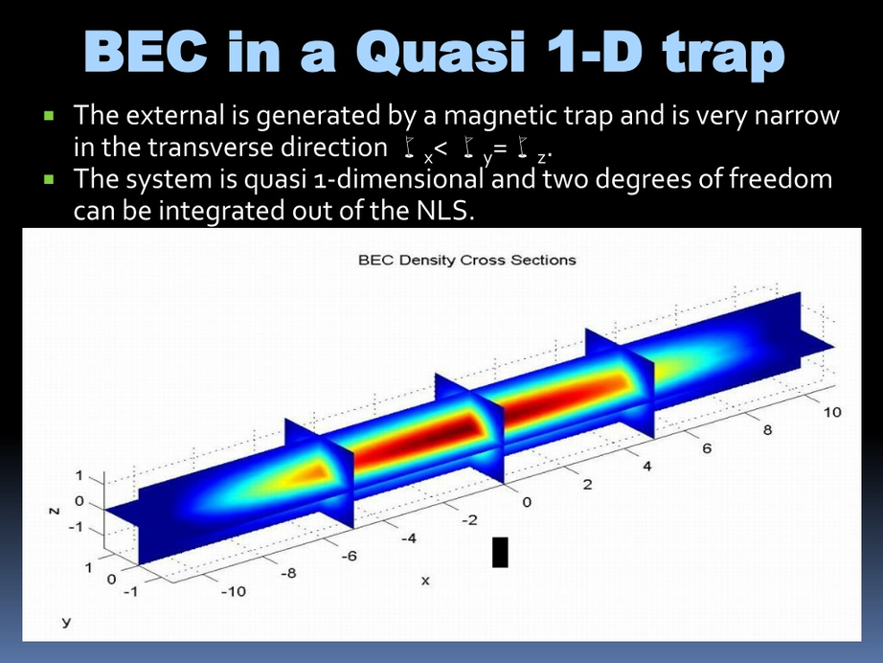
BOSE-EINSTEIN CONDENSATES
A Bose-Einstein Condensate (BEC) is a unique state of matter formed when a gas of bosons is cooled to temperatures near absolute zero.
At these ultra-cold temperatures, a large fraction of the particles occupy the lowest quantum state, behaving as a single coherent quantum entity.
BECs provide a powerful platform to study macroscopic quantum phenomena, such as superfluidity and quantized vortices.
In conventional BECs, particles interact through short-range contact interactions.
In dipolar BECs, however, atoms possess magnetic or electric dipole moments, leading to long-range and anisotropic interactions.
Here we consider that the system in a quasi-one-dimensional (quasi-1D) configuration.
quasi-1D Structure
Image taken from Wikipedia

Slide 4

GROSS PITAEVSKII EQUATION
The behavior of a Bose-Einstein Condensate (BEC) at low temperatures is effectively described by the Gross-Pitaevskii Equation (GPE), a nonlinear Schrödinger equation. It governs the evolution of the macroscopic wavefunction ξ(x,t) of the condensate.
For a dipolar BEC, the GPE includes both contact interactions (local, short-range) and dipole-dipole interactions (nonlocal, long-range). The equation in 1D takes the form:

Slide 5
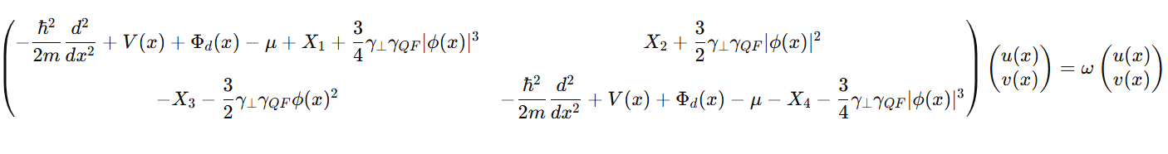
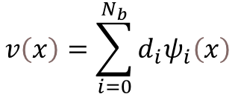
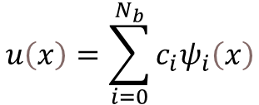
BOGOLIUBOV-de GENNES (BdG) EQUATIONS
The BdG equations describe elementary excitations of a Bose-Einstein Condensate (BEC) around its ground state.
Derived by linearizing the Gross-Pitaevskii Equation, they allow us to study small oscillations in the condensate.
In dipolar BECs, the BdG equations incorporate both contact and dipolar interactions, making the analysis more complex but richer in physics.
the BDG equation:
Where,
$$u\left(x\right)=\sum_{i=0}^{N_{b}}{c_{i}ψ_{i}\left(x\right)}$$
$$v\left(x\right)=\sum_{i=0}^{N_{b}}{d_{i}ψ_{i}\left(x\right)}$$
The eigenvalues ω give the excitation spectrum of the condensate.
Reference: P Blair Blakie et al 2020 Commun. Theor. Phys. 72 085501

Slide 6
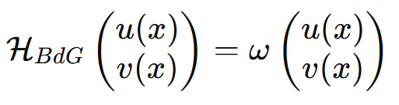


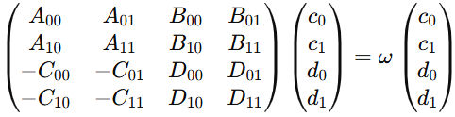
BASIS EXPANSION METHOD
To solve the BdG matrix, we use Basis Expansion method. In 1D, they are written as coupled differential equations for the quasiparticle amplitudes u(x) and v(x):
And if we consider 2 basis then,
Now after matrix multiplication:
$$\left[L\left(x\right)−u+x_{1}+\frac{3}{2}γ{\left|φ\left(κ\right)\right|}^{3}\right]\left(c_{0}ψ_{0}+c_{1}ψ_{1}\right)+\left(X_{2}+\frac{3 γ}{2}{\left|φ\left(κ\right)\right|}^{2}φ\left(κ\right)\right)\left[d_{0}ψ_{0}+d_{1}ψ_{1}\right]$$
First Row
$$\left(X_{3}+\frac{3 γ}{2}{\left|φ∗\left(κ\right)\right|}^{2}φ\left(κ\right)\right)\left(c_{0}ψ_{0}+c_{1}ψ_{1}\right)+\left[L\left(x\right)−u+x_{4}+\frac{3}{2}γ{\left|φ\left(κ\right)\right|}^{3}\right]\left[d_{0}ψ_{0}+d_{1}ψ_{1}\right]$$
Second Row
Now express the BdG operator (after multiplication) in Final Matrix Form - with the result projected onto the harmonic oscillator basis {ψ0​(x),ψ1​(x)} :
Reference: Finite Temperature Effects in the Condensates of Dilute Atomic Gases Thesis by Arko Roy

Slide 7



BASIS EXPANSION METHOD
This is how we get 4X4 matrix for Nb = 2.
So for Nb = n we get 2n X 2n BdG matrix and then by diagonalizing the matrix we get the Eigen value Of that matrix and these Eigen Values are the Energy spectra of Bose Einstein Condensate.
Reference: Finite Temperature Effects in the Condensates of Dilute Atomic Gases Thesis by Arko Roy

Slide 8
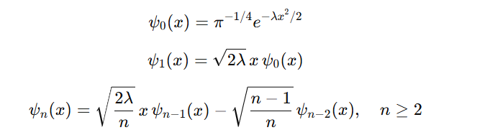

MATHEMATICAL FRAMEWORK
The Potential energy and kinetic energy term of the L can be written as the total energy in quantum state which is (n + 0.5) ℏωx. after Scaling with higher trapping frequency we can write it (n+0.5) ωx /ωz
For Harmonic Oscillator Basis:
Here we are using the Recurrence Relation for Hermite Functions
The wavefunctions are generated using the recursive relation:
Ũx(kx) denotes the Fourier transform of interaction strength and is given as
Reference: P Blair Blakie et al 2020 Commun. Theor. Phys. 72 085501

Slide 9
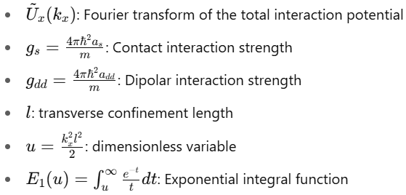


MATHEMATICAL FRAMEWORK
Where,
for limiting behavior:
when u –>0
when u –> infinite or very large
Reference: P Blair Blakie et al 2020 Commun. Theor. Phys. 72 085501

Slide 10
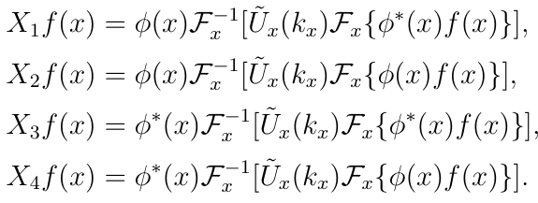


MATHEMATICAL FRAMEWORK
The Function X1, X2, X3 and X4 like this:
Dipolar potential Φd(x):
Quantum Fluctuation term:
Reference: P Blair Blakie et al 2020 Commun. Theor. Phys. 72 085501

Slide 11
CODE
Library Used:
NumPy: Used for efficient numerical computations, array manipulations, and mathematical operations. Eg: np.linspace, np.sqrt, np.exp.
Scipy: Provides scientific computing functions, including linear algebra, numerical integration, and special mathematical functions. Eg: scipy.special, scipy.linalg, scipy.fft , scipy.integrate.simpson
MatPlot: Used for data visualization and plotting graphs. Eg: plt.show(), plt.plot, plt.scatter.
Flow chart:
Input parameters → Compute HO basis → Construct BdG Matrix → Diagonalize → Plot Spectra

Slide 12
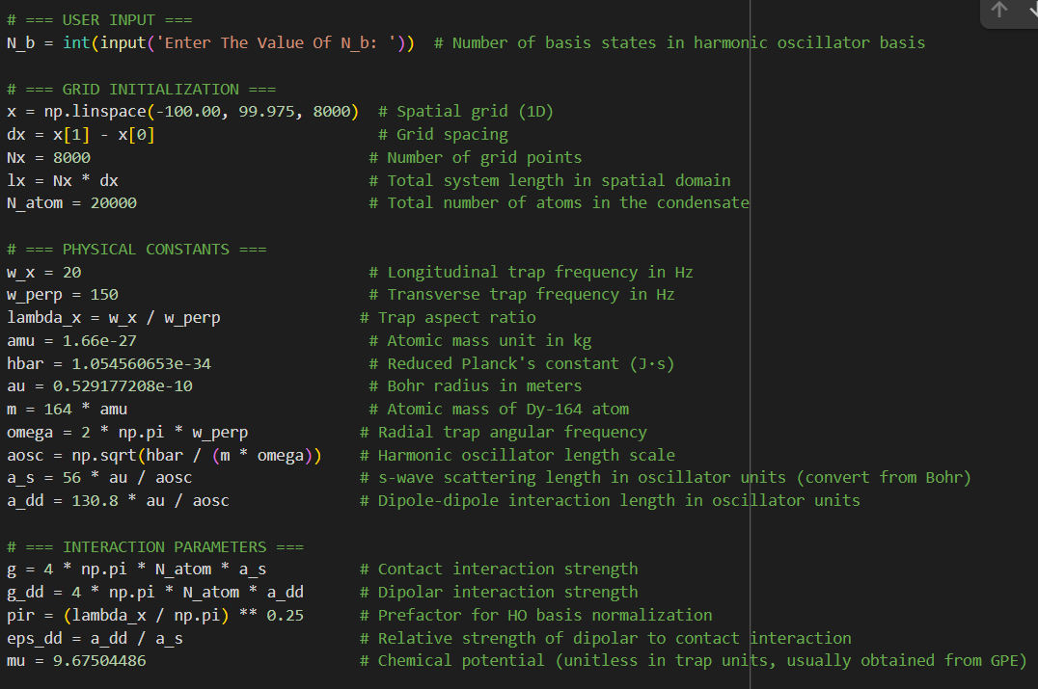
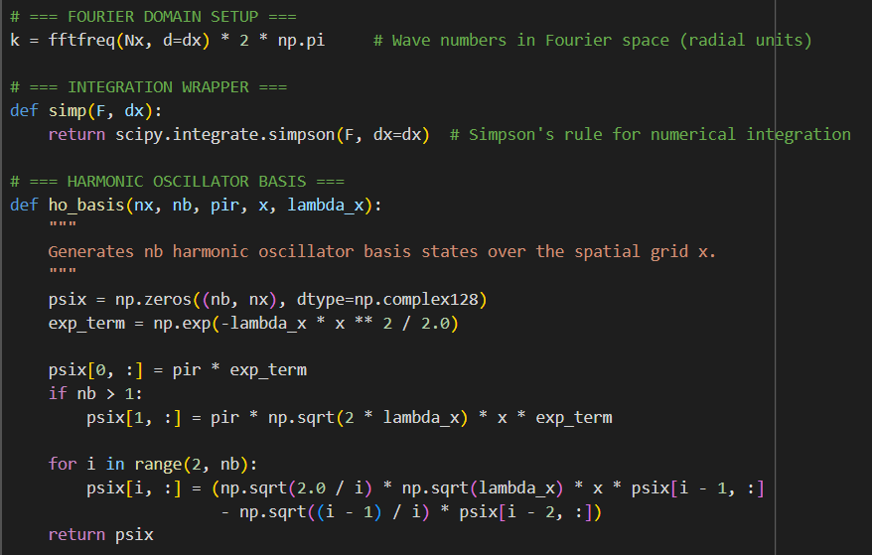
Function For integration and Calculation of Harmonic Oscillator basis
Defining the Input Parameter used:

Slide 13
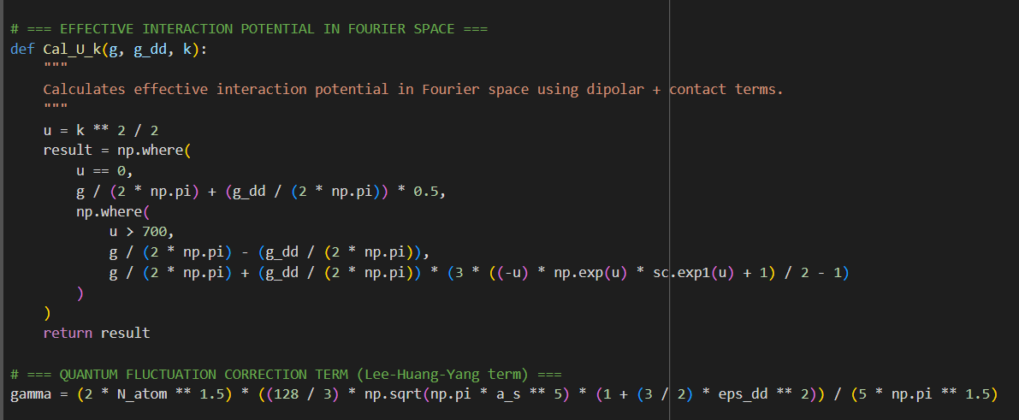
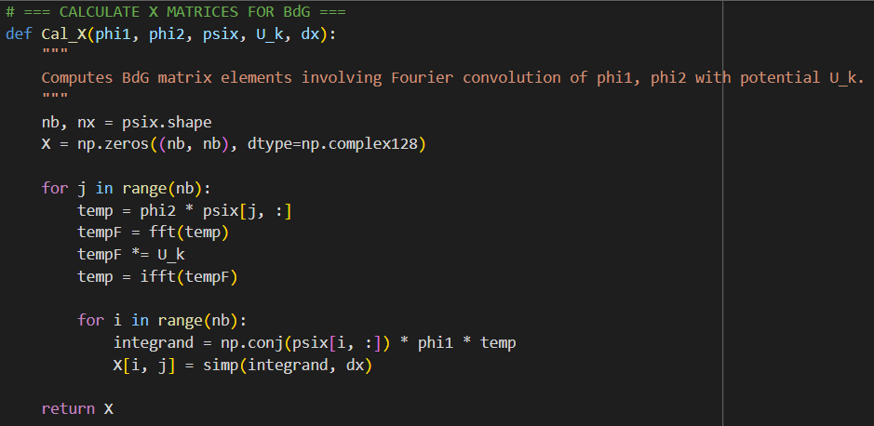
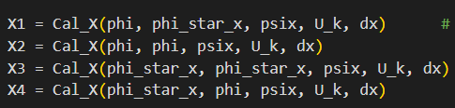
Calculation Of Ũx(kx) and Quantum Fluctuation term:
X1, X2, X3 and X4:

Slide 14
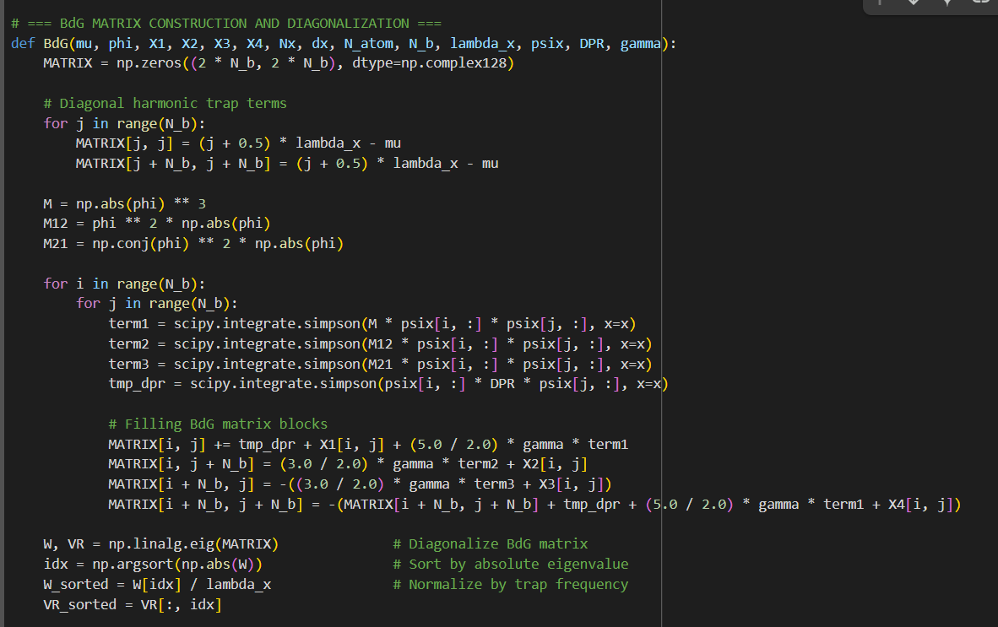
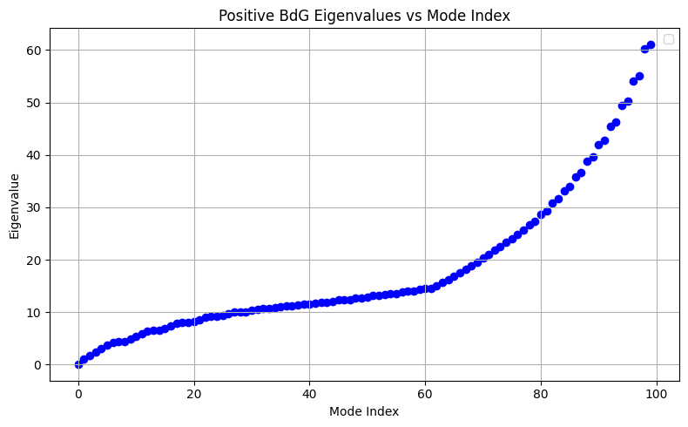
BDG Matrix Formation:

Slide 15
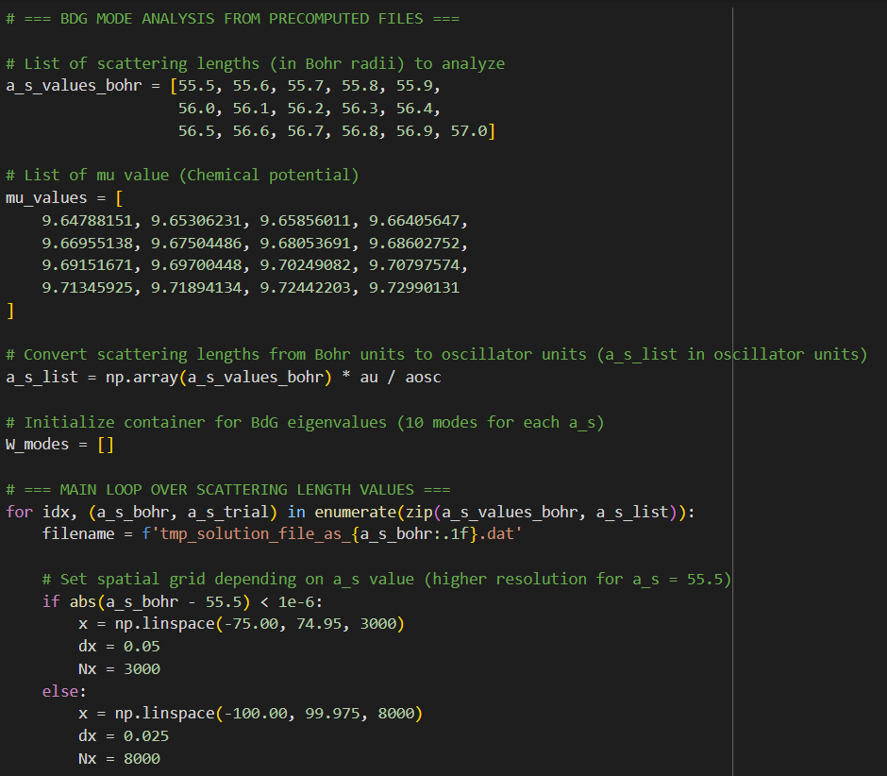
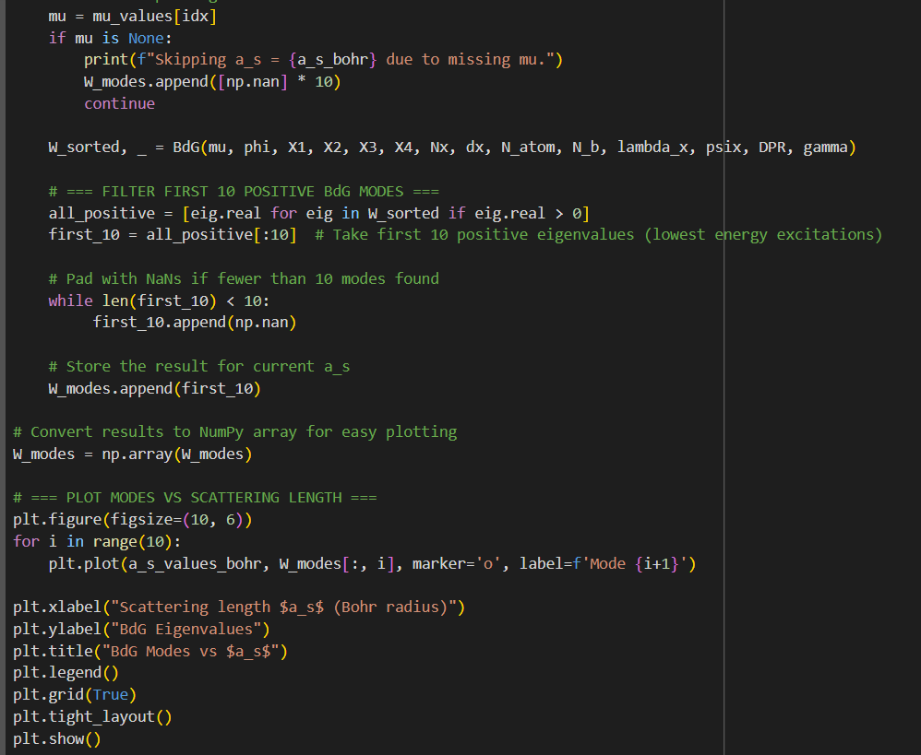
Ploting Of eigen values vs a_s scattering length:

Slide 16
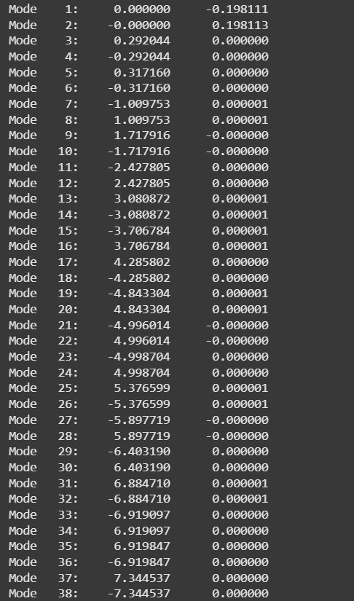
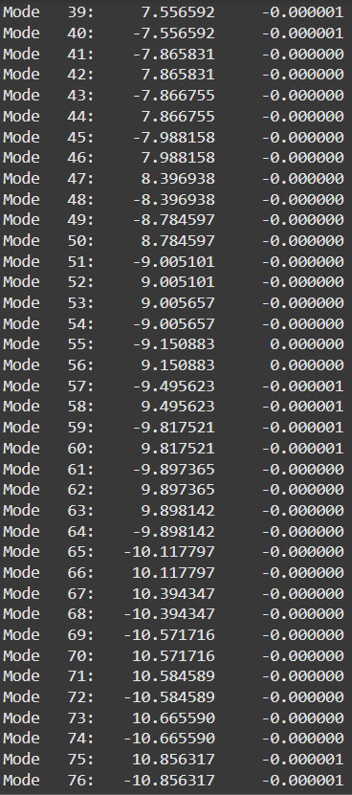
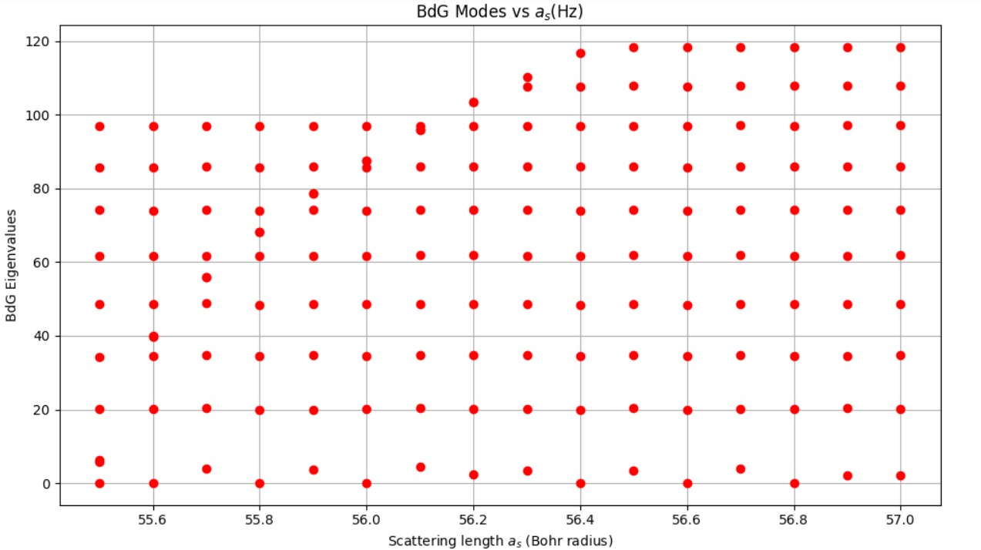
Results and Demonstration
Excitation Energy spectra:
Graph of Eigen vlaue Vs scattering length

Slide 17
Future Enhancements:
Parallelization
Leverage multiprocessing or GPU-based computing to speed up large matrix calculations.
Extension to 3D
Generalize the code to handle 3D dipolar BECs and explore richer excitation spectra.
Web-Based Interface
Develop a user-friendly GUI or website to allow users to run simulations without coding knowledge.

Slide 18

CONCLUSION
Developed a robust Python toolbox to compute excitation spectra of 1D dipolar Bose-Einstein condensates.
Ensures accurate and efficient numerical analysis using BdG formalism and harmonic oscillator basis.
Aids in understanding the role of dipolar interactions and quantum fluctuations in low-dimensional systems.
However, computation time is longer than desired, affecting efficiency.
Optimization will also help in handling larger systems more effectively.

Slide 19
References:
C. Pethick and H. Smith, Bose-Einstein Condensation in Dilute Gases
Lahaye et al., Rep. Prog. Phys., 72 (2009)
W. Bao and Y. Cai, J. Comput. Phys. (2013)
P Blair Blakie et al 2020 Commun. Theor. Phys. 72 085501
NumPy, SciPy, Matplotlib Documentation

Slide 20
THANK
YOU

